Slide 1
Definitions

Slide 2
Definitions
t is the target product
OriAcc(t) is the set of original accounts who posted reviews about t
OriRev(t) is the set of original reviews about t
SockAcc(t) is the set of sockpuppet accounts
SockRev(t) is the set of reviews created by sockpuppets in SockAcc(t)
Fraud(t) ⊆ OriAcc(t) is the set of original fraudsters

Slide 3
Definitions
Bogus(t) = Fraud(t) ∪ SockAcc(t)
Accounts in Bogus(t) are called t-bogus
Notes:
Latexit code:
t\text{-}bogus\text{-}factor = \frac{|Bogus(t)|}{|Fraud(t)|} = \frac{|Fraud(t)|+|SockAcc(t)|}{|Fraud(t)|}
t\text{-}poison\text{-}factor = \frac{|Bogus(t)|}{|OriAcc(t)| + |SockAcc(t)|} = \frac{|Fraud(t)|+|SockAcc(t)|}{|OriAcc(t)| + |SockAcc(t)|}

Slide 4
Definitions
Controls the number of injected sockpuppets
N = number of reviews generated by a sockpuppet
1 unfair review on t (assume the attacker always wants to maximize the rating)
N-1 fair reviews to other random products
We assume (i) ratings from 1 to 5, (ii) the bad guys always want to maximize the rating
* The bad guys may also try to improve their strategy by setting the ratings to 4 or a random number between 4 and 5.
Notes:
Latexit code:
K = \frac{|SockAcc(t)|}{|OriAcc(t)|}
\Leftrightarrow
|SockAcc(t)| = K * |OriAcc(t)|
rating(s, p) = \left \{
\begin{aligned}
&5,\quad \text{if}\ p=t \\
&r\sim N(mean(rating(p)), std(rating(p))),\quad \text{otherwise}
\end{aligned} \right.

Slide 5
A toy example

Slide 6
Experimental setting

Slide 7
Datasets
Source (user), destination (user/product), rating, timestamp
Ground truth data: benign vs fake
Data statistics:
Dataset | #source | #destination | #rating | #legitimate | #fraudster
OTC | 4814 | 5858 | 35592 | 136 | 180
Alpha | 3286 | 3754 | 24186 | 138 | 102
Epinions | 120486 | 13285 | 13668104 | 9291 | 1013
Amazon | 256059 | 74258 | 568454 | 2358 | 241
Notes:
From Andrea to Rui: Please keep this slide continuously updated

Slide 8
Competitors
Rev2: Srijan Kumar, et al. REV2: Fraudulent User Prediction in Rating Platforms. (WSDM 2016)
Bad: Abhinav Mishra, Arnab Bhattacharya. Finding the Bias and Prestige of Nodes in Networks based on Trust Scores. (WWW 2011)
Birdnest: Bryan Hooi, et al. Bayesian Inference for Ratings-Fraud Detection. (SIAM 2016)
Trust: Guan Wang, Sihong Xie, Bing Liu, Philip Yu. Review graph based online store review spammer detection. (ICDM 2011)
FraudEagle: Leman Akoglu et al. Opinion Fraud Detection in Online Reviews by Network Effects. (AAAI 2013)
FRAUDAR: Bryan Hooi et al. Fraudar: Bounding Graph Fraud in the Face of Camouflage. (KDD 2016)
Rsd: Guan Wang et al. Review Graph Based Online Store Review Spammer Detection. (ICDM 2011)
Our goal is a new algorithm that is resistent to this type of attack. So, the competitors are other fraudulent detectors
Notes:
From Andrea to Rui: Please keep this slide continuously updated

Slide 9
Parameters
Dataset: D ∈ {Alpha, OTC, Epinions, Amazon}
Competitor: A ∈ {Rev2, Bad, Birdnest, Trust, FraudEagle, FRAUDAR, Rsd}
Number of target products: T = 100
Ratio sockpuppets/original: ∈ {0%, 10%, …, 100%}
Reviews by each sockpuppet: N ∈ {1, 5, 10, 15, ..., 50}
Top percentile assumed as fraudulent: q ∈ {0.5%, 1%, 3%, 5%, 10%}

Slide 10
Experimental round
For each dataset D and competitor A
For each K and N
For each target t (i.e., T times)
Evaluate:
Precision when varying q
Recall when varying q
F1 score when varying q
Average the results over t
Notes:
From Rui to Andrea: What about the t-poison-factor and t-bogus-factor?
From Andrea to Rui: Let’s just vary K for now. Given K we can always compute the corresponding t-poison-factor and t-bogus-factor, so I think it will be a matter of what we eventually prefer to present.

Slide 11
Experimental results

Slide 12
REV2 - OTC
Heatmaps for F1, precision, and recall when varying K&N with q = 0.5%
Heatmaps for F1, precision, and recall when varying K&N with q = 1%
Heatmaps for F1, precision, and recall when varying K&N with q = 3%
Heatmaps for F1, precision, and recall when varying K&N with q = 5%
Heatmaps for F1, precision, and recall when varying K&N with q = 10%
Quick comments/discussion

Slide 13
Bad - OTC
Worst k/n pair are consistent when varying q

Slide 14
Birdnest - OTC

Slide 15
Trust - OTC
The precision is much higher after attack, but recall and f1 are much lower.

Slide 16
FraudEagle - OTC

Slide 17
FRAUDAR - OTC

Slide 18
Rsd - OTC

Slide 19
REV2 - Alpha
When q is 0.5% and 1%, the precision doesn’t hurt at all

Slide 20
Bad - Alpha

Slide 21
Birdnest - Alpha

Slide 22
Trust - Alpha

Slide 23
FraudEagle - Alpha

Slide 24
FRAUDAR - Alpha

Slide 25
Rsd - Alpha

Slide 26
REV2 - Epinions
Heatmaps for F1, precision, and recall when varying K&N with q = 0.5%
Heatmaps for F1, precision, and recall when varying K&N with q = 1%
Heatmaps for F1, precision, and recall when varying K&N with q = 3%
Heatmaps for F1, precision, and recall when varying K&N with q = 5%
Heatmaps for F1, precision, and recall when varying K&N with q = 10%
Quick comments/discussion

Slide 27
Bad - Epinions

Slide 28
Birdnest - Epinions

Slide 29
Trust - Epinions
Heatmaps for F1, precision, and recall when varying K&N with q = 0.5%
Heatmaps for F1, precision, and recall when varying K&N with q = 1%
Heatmaps for F1, precision, and recall when varying K&N with q = 3%
Heatmaps for F1, precision, and recall when varying K&N with q = 5%
Heatmaps for F1, precision, and recall when varying K&N with q = 10%
Quick comments/discussion

Slide 30
FraudEagle - Epinions
Heatmaps for F1, precision, and recall when varying K&N with q = 0.5%
Heatmaps for F1, precision, and recall when varying K&N with q = 1%
Heatmaps for F1, precision, and recall when varying K&N with q = 3%
Heatmaps for F1, precision, and recall when varying K&N with q = 5%
Heatmaps for F1, precision, and recall when varying K&N with q = 10%
Quick comments/discussion

Slide 31
FRAUDAR - Epinions

Slide 32
Rsd - Epinions

Slide 33
REV2 - Amazon
Heatmaps for F1, precision, and recall when varying K&N with q = 0.5%
Heatmaps for F1, precision, and recall when varying K&N with q = 1%
Heatmaps for F1, precision, and recall when varying K&N with q = 3%
Heatmaps for F1, precision, and recall when varying K&N with q = 5%
Heatmaps for F1, precision, and recall when varying K&N with q = 10%
Quick comments/discussion

Slide 34
Bad - Amazon

Slide 35
Birdnest - Amazon

Slide 36
Trust - Amazon

Slide 37
FraudEagle - Amazon

Slide 38
FRAUDAR - Amazon
Heatmaps for F1, precision, and recall when varying K&N with q = 0.5%
Heatmaps for F1, precision, and recall when varying K&N with q = 1%
Heatmaps for F1, precision, and recall when varying K&N with q = 3%
Heatmaps for F1, precision, and recall when varying K&N with q = 5%
Heatmaps for F1, precision, and recall when varying K&N with q = 10%
Quick comments/discussion

Slide 39
Rsd - Amazon

Slide 40
Worst cases table Precision - q = 0.5%
 | REV2 | Bad | Birdnest | Trust | FraudEagle | FRAUDAR | Rsd
OTC | 0.000 k=0.10 n=1 | -0.094 k=0.50 n=35 | 0.979 k=0.10 n=45 | 0.796 k=0.80 n=45 | 0.500 k=0.10 n=40 | 0.000 k=0.10 n=1 | 0.630 k=0.20 n=5
Alpha | 0.000 k=0.10 n=1 | 0.000 k=0.30 n=50 | 1.674 k=0.30 n=1 | 0.885 k=0.20 n=50 | 0.348 k=0.40 n=50 | -0.000 k=0.10 n=1 | 0.593 k=0.50 n=15
Epinions |  | -0.340 k=0.90 n=50 | 2.563 k=0.10 n=1 | 1.272 k=0.10 n=50 |  | -0.688 k=0.70 n=1 | -0.249 k=0.20 n=15
Amazon | -1.000 k=0.30 n=20 | -0.212 k=0.60 n=25 | 1.005 k=0.10 n=30 | -0.048 k=0.10 n=45 | -0.235 k=0.60 n=40 | -0.347 k=0.90 n=30 | -0.115 k=0.40 n=5
More in-depth comments/discussion

Slide 41
Worst cases table Recall - q = 0.5%
 | REV2 | Bad | Birdnest | Trust | FraudEagle | FRAUDAR | Rsd
OTC | -0.916 k=0.90 n=1 | -0.809 k=0.90 n=50 | -0.679 k=0.90 n=30 | -0.708 k=0.90 n=50 | -0.768 k=0.90 n=45 | -0.851 k=0.90 n=1 | -0.761 k=0.90 n=1
Alpha | -0.863 k=0.90 n=1 | -0.836 k=0.90 n=40 | -0.616 k=0.90 n=25 | -0.703 k=0.90 n=35 | -0.752 k=0.90 n=50 | -0.880 k=0.90 n=1 | -0.731 k=0.90 n=10
Epinions |  | -0.979 k=0.90 n=50 | -0.880 k=0.90 n=20 | -0.917 k=0.90 n=50 |  | -0.996 k=0.70 n=1 | -0.983 k=0.60 n=50
Amazon | -1.000 k=0.30 n=20 | -0.975 k=0.90 n=5 | -0.931 k=0.90 n=20 | -0.974 k=0.90 n=40 | -0.972 k=0.80 n=1 | -0.977 k=0.70 n=1 | -0.972 k=0.80 n=5
More in-depth comments/discussion

Slide 42
Worst cases table F1 - q = 0.5%
F1 relies on recall.
 | REV2 | Bad | Birdnest | Trust | FraudEagle | FRAUDAR | Rsd
OTC | -0.848 k=0.90 n=1 | -0.697 k=0.90 n=50 | -0.490 k=0.90 n=30 | -0.547 k=0.90 n=50 | -0.632 k=0.90 n=45 | -0.760 k=0.90 n=1 | -0.615 k=0.90 n=1
Alpha | -0.781 k=0.90 n=1 | -0.755 k=0.90 n=40 | -0.393 k=0.90 n=25 | -0.547 k=0.90 n=35 | -0.628 k=0.90 n=50 | -0.800 k=0.90 n=1 | -0.589 k=0.90 n=10
Epinions |  | -0.961 k=0.90 n=50 | -0.798 k=0.90 n=20 | -0.861 k=0.90 n=50 |  | -0.994 k=0.70 n=1 | -0.964 k=0.60 n=50
Amazon | -1.000 k=0.30 n=20 | -0.955 k=0.90 n=5 | -0.876 k=0.90 n=20 | -0.954 k=0.90 n=40 | -0.949 k=0.80 n=1 | -0.957 k=0.70 n=1 | -0.948 k=0.80 n=5

Slide 43
Worst cases table Precision - q = 1%
 | REV2 | Bad | Birdnest | Trust | FraudEagle | FRAUDAR | Rsd
OTC | 0.000 k=0.10 n=1 | -0.104 k=0.50 n=35 | 0.979 k=0.10 n=45 | 0.796 k=0.90 n=50 | 0.490 k=0.70 n=45 | 0.000 k=0.10 n=1 | 0.630 k=0.20 n=5
Alpha | 0.000 k=0.10 n=1 | 0.000 k=0.30 n=50 | 1.674 k=0.30 n=1 | 0.885 k=0.20 n=50 | 0.348 k=0.40 n=50 | -0.000 k=0.10 n=1 | 0.593 k=0.50 n=15
Epinions |  | -0.411 k=0.90 n=50 | 2.983 k=0.10 n=1 | 1.742 k=0.10 n=50 |  | -0.270 k=0.10 n=1 | -0.222 k=0.30 n=35
Amazon | -1.000 k=0.30 n=20 | -0.291 k=0.60 n=25 | 1.005 k=0.10 n=30 | -0.048 k=0.10 n=45 | -0.205 k=0.60 n=40 | -0.096 k=0.20 n=25 | -0.059 k=0.50 n=30
More in-depth comments/discussion

Slide 44
Worst cases table Recall - q = 1%
 | REV2 | Bad | Birdnest | Trust | FraudEagle | FRAUDAR | Rsd
OTC | -0.916 k=0.90 n=1 | -0.809 k=0.90 n=50 | -0.677 k=0.90 n=30 | -0.706 k=0.90 n=50 | -0.768 k=0.90 n=45 | -0.851 k=0.90 n=1 | -0.759 k=0.90 n=1
Alpha | -0.863 k=0.90 n=1 | -0.836 k=0.90 n=40 | -0.615 k=0.90 n=25 | -0.702 k=0.90 n=30 | -0.752 k=0.90 n=50 | -0.879 k=0.90 n=1 | -0.731 k=0.90 n=10
Epinions |  | -0.981 k=0.90 n=50 | -0.872 k=0.90 n=20 | -0.908 k=0.90 n=50 |  | -0.981 k=0.80 n=1 | -0.960 k=0.60 n=50
Amazon | -1.000 k=0.30 n=20 | -0.972 k=0.90 n=5 | -0.921 k=0.80 n=20 | -0.970 k=0.90 n=40 | -0.968 k=0.80 n=1 | -0.974 k=0.70 n=1 | -0.968 k=0.80 n=5
More in-depth comments/discussion

Slide 45
Worst cases table F1 - q = 1%
Similar with q=0.5%
 | REV2 | Bad | Birdnest | Trust | FraudEagle | FRAUDAR | Rsd
OTC | -0.848 k=0.90 n=1 | -0.697 k=0.90 n=50 | -0.488 k=0.90 n=30 | -0.545 k=0.90 n=50 | -0.632 k=0.90 n=45 | -0.760 k=0.90 n=1 | -0.613 k=0.90 n=1
Alpha | -0.781 k=0.90 n=1 | -0.755 k=0.90 n=40 | -0.392 k=0.90 n=25 | -0.546 k=0.90 n=30 | -0.628 k=0.90 n=50 | -0.799 k=0.90 n=1 | -0.589 k=0.90 n=10
Epinions |  | -0.961 k=0.90 n=50 | -0.752 k=0.90 n=20 | -0.815 k=0.90 n=50 |  | -0.965 k=0.80 n=1 | -0.913 k=0.60 n=50
Amazon | -1.000 k=0.30 n=20 | -0.950 k=0.90 n=5 | -0.858 k=0.90 n=20 | -0.946 k=0.90 n=40 | -0.943 k=0.80 n=1 | -0.950 k=0.70 n=1 | -0.942 k=0.80 n=5

Slide 46
Worst cases table Precision - q = 3%
 | REV2 | Bad | Birdnest | Trust | FraudEagle | FRAUDAR | Rsd
OTC | 0.000 k=0.10 n=1 | -0.047 k=0.20 n=45 | 1.025 k=0.10 n=45 | 0.829 k=0.80 n=50 | 0.477 k=0.30 n=45 | 0.000 k=0.10 n=1 | 0.667 k=0.20 n=5
Alpha | -0.064 k=0.80 n=1 | -0.028 k=0.40 n=50 | 1.725 k=0.30 n=1 | 0.904 k=0.20 n=40 | 0.370 k=0.40 n=50 | -0.013 k=0.30 n=1 | 0.648 k=0.50 n=15
Epinions |  | -0.513 k=0.90 n=50 | 4.636 k=0.10 n=1 | 3.836 k=0.10 n=50 |  | -0.315 k=0.90 n=1 | -0.249 k=0.10 n=1
Amazon | -0.760 k=0.30 n=20 | -0.401 k=0.90 n=40 | 1.092 k=0.10 n=30 | -0.003 k=0.10 n=45 | -0.154 k=0.20 n=1 | 0.074 k=0.20 n=25 | 0.078 k=0.20 n=15
More in-depth comments/discussion

Slide 47
Worst cases table Recall - q = 3%
 | REV2 | Bad | Birdnest | Trust | FraudEagle | FRAUDAR | Rsd
OTC | -0.910 k=0.90 n=1 | -0.799 k=0.90 n=50 | -0.662 k=0.90 n=30 | -0.693 k=0.90 n=45 | -0.760 k=0.90 n=45 | -0.850 k=0.90 n=1 | -0.750 k=0.90 n=5
Alpha | -0.860 k=0.90 n=1 | -0.832 k=0.90 n=50 | -0.592 k=0.90 n=25 | -0.685 k=0.90 n=25 | -0.746 k=0.90 n=50 | -0.874 k=0.90 n=1 | -0.718 k=0.90 n=45
Epinions |  | -0.979 k=0.90 n=50 | -0.801 k=0.90 n=20 | -0.836 k=0.90 n=50 |  | -0.989 k=0.90 n=1 | -0.919 k=0.60 n=50
Amazon | -0.981 k=0.30 n=20 | -0.961 k=0.90 n=50 | -0.868 k=0.90 n=40 | -0.938 k=0.90 n=40 | -0.944 k=0.80 n=1 | -0.936 k=0.70 n=1 | -0.943 k=0.80 n=5
More in-depth comments/discussion

Slide 48
Worst cases table F1 - q = 3%
 | REV2 | Bad | Birdnest | Trust | FraudEagle | FRAUDAR | Rsd
OTC | -0.837 k=0.90 n=1 | -0.681 k=0.90 n=50 | -0.462 k=0.90 n=30 | -0.523 k=0.90 n=45 | -0.619 k=0.90 n=45 | -0.759 k=0.90 n=1 | -0.595 k=0.90 n=5
Alpha | -0.775 k=0.90 n=1 | -0.749 k=0.90 n=50 | -0.353 k=0.90 n=25 | -0.518 k=0.90 n=25 | -0.619 k=0.90 n=50 | -0.790 k=0.90 n=1 | -0.568 k=0.90 n=45
Epinions |  | -0.947 k=0.90 n=50 | -0.453 k=0.90 n=20 | -0.514 k=0.90 n=50 |  | -0.963 k=0.90 n=1 | -0.773 k=0.60 n=50
Amazon | -0.966 k=0.30 n=20 | -0.930 k=0.90 n=50 | -0.762 k=0.90 n=40 | -0.888 k=0.90 n=40 | -0.898 k=0.80 n=1 | -0.882 k=0.90 n=40 | -0.896 k=0.80 n=5
More in-depth comments/discussion

Slide 49
Worst cases table Precision - q = 5%
 | REV2 | Bad | Birdnest | Trust | FraudEagle | FRAUDAR | Rsd
OTC | -0.040 k=0.90 n=1 | -0.016 k=0.10 n=30 | 0.991 k=0.10 n=45 | 0.944 k=0.70 n=50 | 0.457 k=0.30 n=50 | 0.000 k=0.10 n=1 | 0.631 k=0.20 n=5
Alpha | -0.170 k=0.90 n=1 | -0.111 k=0.60 n=50 | 1.735 k=0.10 n=25 | 0.910 k=0.10 n=40 | 0.348 k=0.70 n=50 | 0.027 k=0.50 n=1 | 0.657 k=0.30 n=15
Epinions |  | -0.417 k=0.90 n=50 | 5.326 k=0.10 n=1 | 6.053 k=0.10 n=50 |  | -0.179 k=0.50 n=1 | 0.187 k=0.10 n=1
Amazon | -0.618 k=0.30 n=20 | -0.470 k=0.90 n=40 | 1.138 k=0.10 n=50 | 0.010 k=0.10 n=45 | -0.148 k=0.20 n=1 | 0.353 k=0.20 n=25 | 0.033 k=0.20 n=15
More in-depth comments/discussion

Slide 50
Worst cases table Recall - q = 5%
Rev2 become the worst case in OTC ( it was Fraudar).
 | REV2 | Bad | Birdnest | Trust | FraudEagle | FRAUDAR | Rsd
OTC | -0.907 k=0.90 n=1 | -0.776 k=0.90 n=50 | -0.640 k=0.90 n=30 | -0.667 k=0.90 n=45 | -0.742 k=0.90 n=50 | -0.839 k=0.90 n=1 | -0.736 k=0.90 n=1
Alpha | -0.855 k=0.90 n=1 | -0.795 k=0.90 n=45 | -0.524 k=0.90 n=25 | -0.635 k=0.90 n=20 | -0.708 k=0.90 n=50 | -0.845 k=0.80 n=1 | -0.675 k=0.90 n=5
Epinions |  | -0.976 k=0.90 n=50 | -0.770 k=0.90 n=20 | -0.748 k=0.90 n=50 |  | -0.984 k=0.50 n=1 | -0.838 k=0.10 n=1
Amazon | -0.952 k=0.30 n=20 | -0.952 k=0.90 n=50 | -0.805 k=0.70 n=50 | -0.904 k=0.90 n=40 | -0.920 k=0.60 n=40 | -0.901 k=0.70 n=1 | -0.902 k=0.80 n=5

Slide 51
Worst cases table F1 - q = 5%
 | REV2 | Bad | Birdnest | Trust | FraudEagle | FRAUDAR | Rsd
OTC | -0.832 k=0.90 n=1 | -0.642 k=0.90 n=45 | -0.429 k=0.90 n=35 | -0.476 k=0.90 n=45 | -0.588 k=0.90 n=50 | -0.739 k=0.90 n=1 | -0.575 k=0.90 n=1
Alpha | -0.768 k=0.90 n=1 | -0.695 k=0.90 n=45 | -0.246 k=0.90 n=25 | -0.442 k=0.90 n=20 | -0.561 k=0.90 n=50 | -0.744 k=0.80 n=1 | -0.501 k=0.90 n=5
Epinions |  | -0.923 k=0.90 n=50 | -0.171 k=0.90 n=20 | -0.053 k=0.90 n=50 |  | -0.927 k=0.50 n=1 | -0.543 k=0.10 n=1
Amazon | -0.921 k=0.30 n=20 | -0.916 k=0.90 n=50 | -0.653 k=0.70 n=50 | -0.831 k=0.90 n=40 | -0.859 k=0.60 n=40 | -0.817 k=0.70 n=1 | -0.823 k=0.80 n=5
More in-depth comments/discussion

Slide 52
Worst cases table Precision - q = 10%
 | REV2 | Bad | Birdnest | Trust | FraudEagle | FRAUDAR | Rsd
OTC | 0.000 k=0.10 n=1 | 0.101 k=0.10 n=35 | 1.017 k=0.10 n=45 | 0.944 k=0.90 n=50 | 0.475 k=0.10 n=50 | -0.007 k=0.30 n=1 | 0.700 k=0.20 n=5
Alpha | -0.221 k=0.90 n=1 | -0.032 k=0.30 n=50 | 1.406 k=0.10 n=45 | 0.915 k=0.10 n=40 | 0.340 k=0.10 n=45 | -0.110 k=0.90 n=1 | 0.688 k=0.30 n=15
Epinions |  | -0.354 k=0.20 n=50 | 7.913 k=0.10 n=1 | 10.903 k=0.10 n=50 |  | 0.004 k=0.30 n=1 | 2.694 k=0.10 n=1
Amazon | -0.256 k=0.10 n=35 | -0.478 k=0.30 n=40 | 1.087 k=0.10 n=35 | 0.148 k=0.10 n=45 | -0.010 k=0.10 n=40 | 0.249 k=0.10 n=40 | 0.157 k=0.10 n=25
More in-depth comments/discussion

Slide 53
Worst cases table Recall - q = 10%
 | REV2 | Bad | Birdnest | Trust | FraudEagle | FRAUDAR | Rsd
OTC | -0.801 k=0.50 n=1 | -0.673 k=0.60 n=40 | -0.525 k=0.90 n=30 | -0.569 k=0.90 n=50 | -0.649 k=0.90 n=50 | -0.743 k=0.70 n=1 | -0.642 k=0.90 n=5
Alpha | -0.834 k=0.90 n=1 | -0.748 k=0.90 n=45 | -0.390 k=0.90 n=40 | -0.524 k=0.90 n=50 | -0.616 k=0.90 n=50 | -0.812 k=0.90 n=1 | -0.576 k=0.90 n=45
Epinions |  | -0.953 k=0.60 n=50 | -0.674 k=0.90 n=20 | -0.522 k=0.90 n=50 |  | -0.972 k=0.30 n=1 | -0.793 k=0.80 n=45
Amazon | -0.852 k=0.20 n=15 | -0.927 k=0.70 n=50 | -0.675 k=0.70 n=50 | -0.832 k=0.90 n=40 | -0.854 k=0.90 n=45 | -0.799 k=0.70 n=1 | -0.810 k=0.90 n=1
More in-depth comments/discussion

Slide 54
Worst cases table F1 - q = 10%
Similar with q=5%.
 | REV2 | Bad | Birdnest | Trust | FraudEagle | FRAUDAR | Rsd
OTC | -0.662 k=0.50 n=1 | -0.502 k=0.50 n=40 | -0.258 k=0.90 n=35 | -0.334 k=0.90 n=50 | -0.449 k=0.90 n=50 | -0.588 k=0.70 n=1 | -0.433 k=0.90 n=5
Alpha | -0.735 k=0.90 n=1 | -0.624 k=0.90 n=45 | -0.051 k=0.90 n=40 | -0.288 k=0.90 n=50 | -0.432 k=0.90 n=50 | -0.704 k=0.90 n=1 | -0.358 k=0.90 n=45
Epinions |  | -0.798 k=0.60 n=50 | 0.719 k=0.90 n=20 | 1.573 k=0.90 n=50 |  | -0.769 k=0.30 n=1 | 0.250 k=0.80 n=45
Amazon | -0.761 k=0.20 n=15 | -0.868 k=0.70 n=50 | -0.427 k=0.70 n=50 | -0.693 k=0.60 n=20 | -0.732 k=0.60 n=40 | -0.628 k=0.70 n=1 | -0.649 k=0.90 n=1

Slide 55
Original fraudulent accounts changes

Slide 56
Sockpuppet account changes (needs update)

Slide 57
Original fraud + Sockpuppet changes

Slide 58
Budget model: Original fraudulent accounts changes

Slide 59
Budget model: Sockpuppet account changes (need updates)

Slide 60
Budget model: Original fraud + Sockpuppet changes

Slide 61

Assumption for the budget model
The cost for creating accounts are identical on the same website(data)
The cost for writing reviews are identical on the same website
The attacker use all the sockpuppets $s_{i}$ in the same way
The numbers of reviews $n_{review }^{s_{i}}$ follow the same distribution, to simplify, we assume they have the same value
Data | Average # fraudulent accounts per target | Std of # frauds | Average # reviews per fraudulent account | Std of # reviews
OTC | 1.81 | 2.33 | 13.94 | 37.63
Alpha | 1.83 | 1.79 | 19.31 | 40.80
Epinions | 3.63 | 9.99 | 68.07 | 237.41
Amazon | 1.67 | 1.62 | 9.05 | 8.60

Slide 62
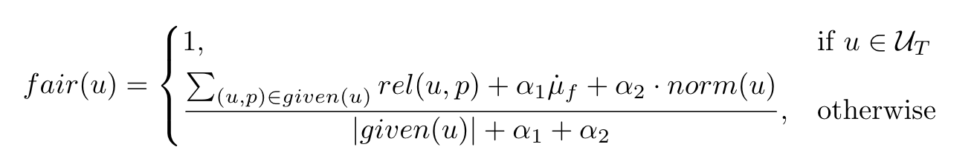
Detection model with trusted users
Include a set of trusted users
100% fairness for users
100% reliability for reviews
If the user is trusted.
Fairness inferred from reliability
Cold start
Fairness inferred from normality of the behavior

Slide 63
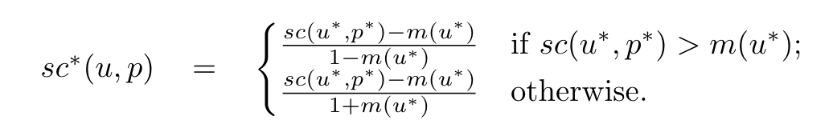
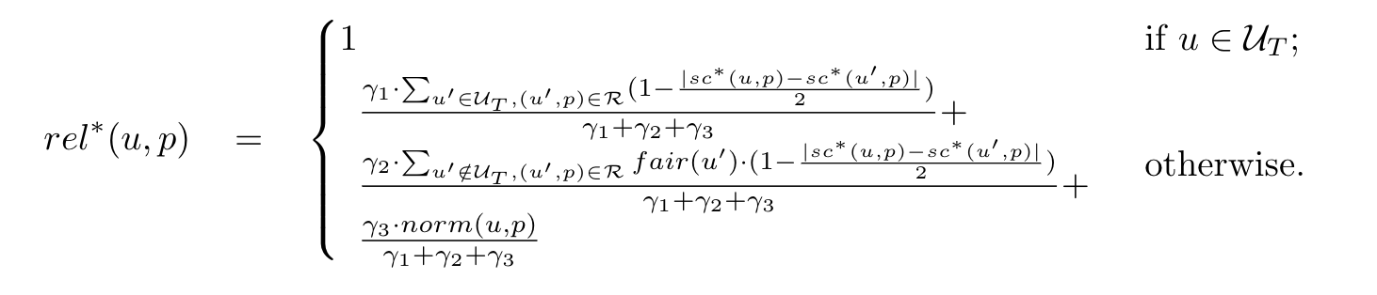
Detection model with trusted users
Distance to mean. Normalized to [-1, 1].
Reliability inferred from trusted users.
Reliability inferred from untrusted users.
Reliability inferred from normality score.

Slide 64
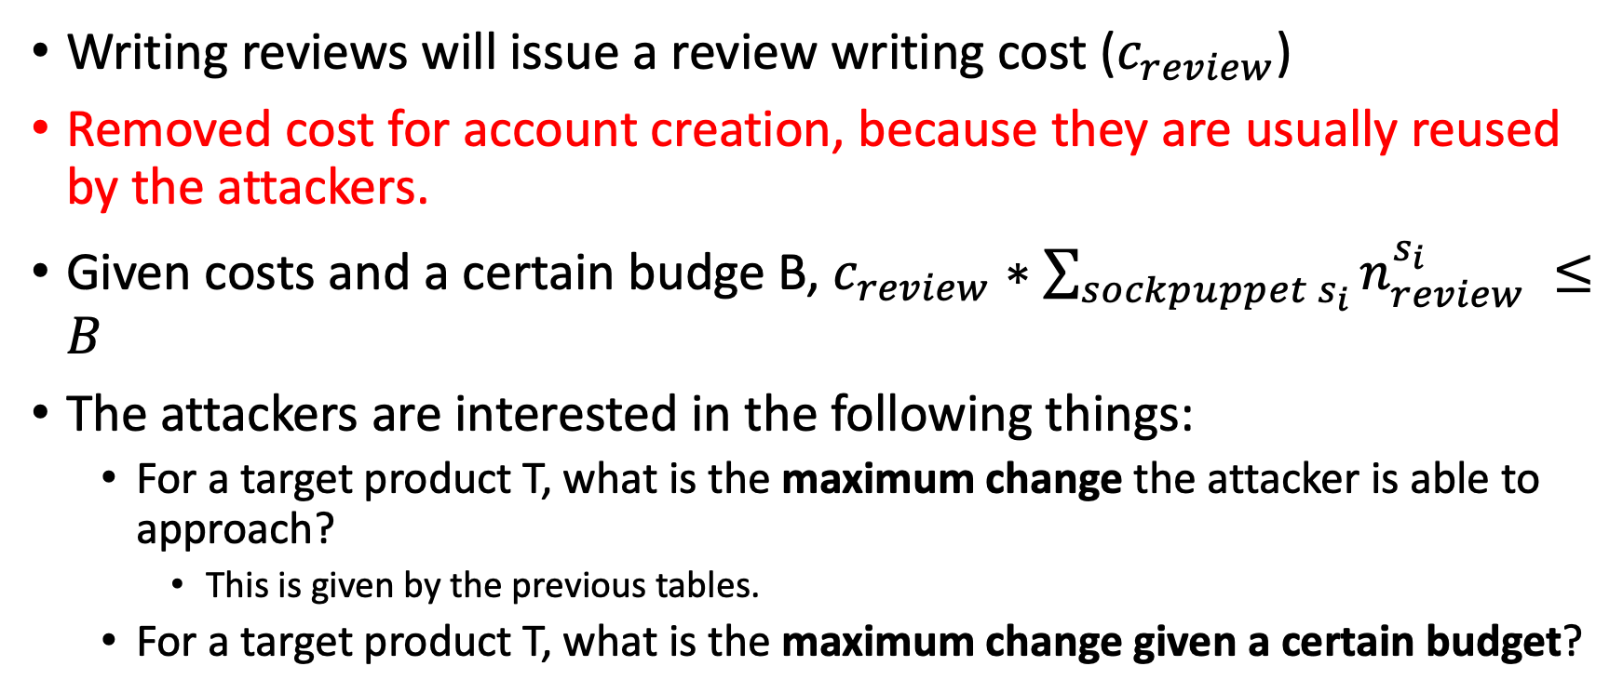
Attack budget model
Writing reviews will issue a review writing cost ($c_{review}$)
Removed cost for account creation, because they are usually reused by the attackers.
Given costs and a certain budge B, $c_{review}∗\sum_{sockpuppet s_{i}}{n_{review}^{s_{i}}} ≤B$
The attackers are interested in the following things:
For a target product T, what is the maximum change the attacker is able to approach?
This is given by the previous tables.
For a target product T, what is the maximum change given a certain budget?

Slide 65
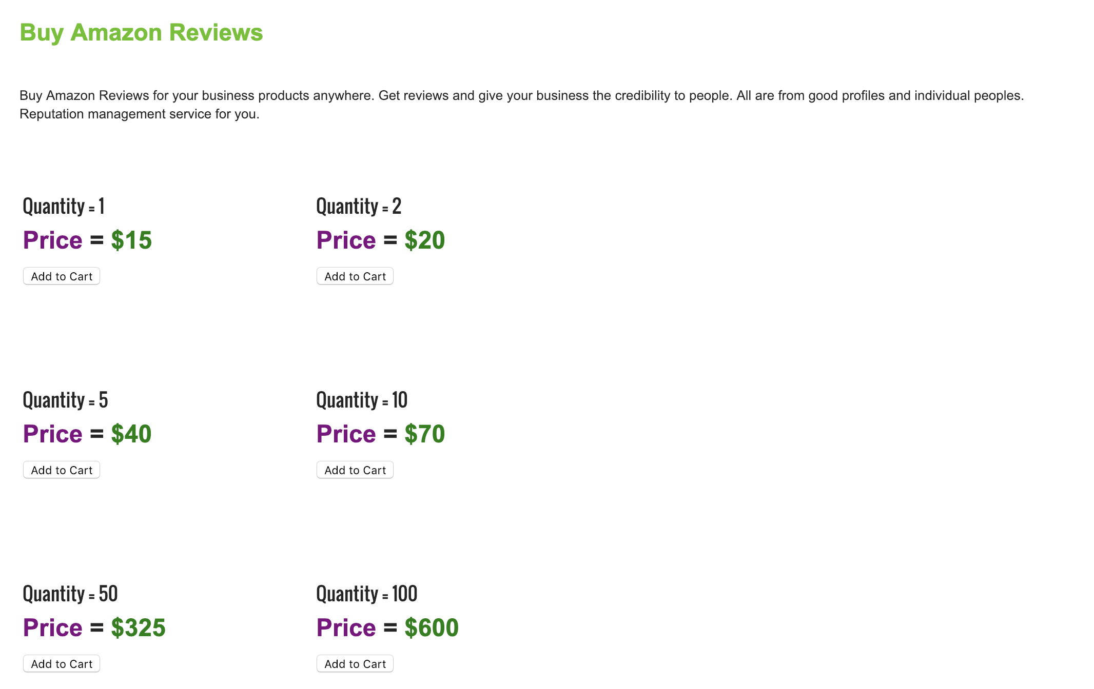
Cost for fake accounts and reviews
https://allsocialmediasolution.us/buy-amazon-reviews/
The cost per review ranges from $6, $7, $8, $10, and $15 and the price varies by packages.

Slide 66
Price of fake reviews on major websites
Website | Price | Source
Amazon* | $6, 8, 10, 15 | https://allsocialmediasolution.us/buy-amazon-reviews/
Epinions* | $6, 8, 10, 15 | https://allsocialmediasolution.us/buy-epinions-reviews/
Yelp | $1-10 | https://pubsonline.informs.org/doi/pdf/10.1287/mnsc.2015.2304
Tripadvisor | $1 | AppWatcher: unveiling the underground market of trading mobile app reviews (WiSec’ 15)
iOS App Store | $3 | https://reviews-up.com/ios-app-reviews/
Android reviews | $4 | https://reviews-up.com/android-app-reviews/

Slide 67

Experiments for the budget model
For each dataset D
For a budget and costs $c_{review}$
For algorithm A and target T
Find all the eligible numbers of sockpuppets and numbers of total reviews
Find the largest change (drop) of the metrics

Slide 68
Algorithm performance for budget model (amazon) q=0.5%

Slide 69
Algorithm performance for budget model (amazon) q=1%

Slide 70
Algorithm performance for budget model (amazon) q=3%

Slide 71
Algorithm performance for budget model (amazon) q=5%

Slide 72
Algorithm performance for budget model (amazon) q=10%

Slide 73
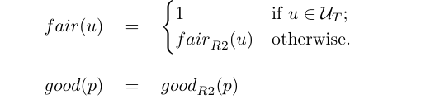
Model: Trusted users
Distance to mean. Normalized to [-1, 1].
Reliability inferred from trusted users.
Reliability inferred from untrusted users.
Reliability inferred from normality score.

Slide 74
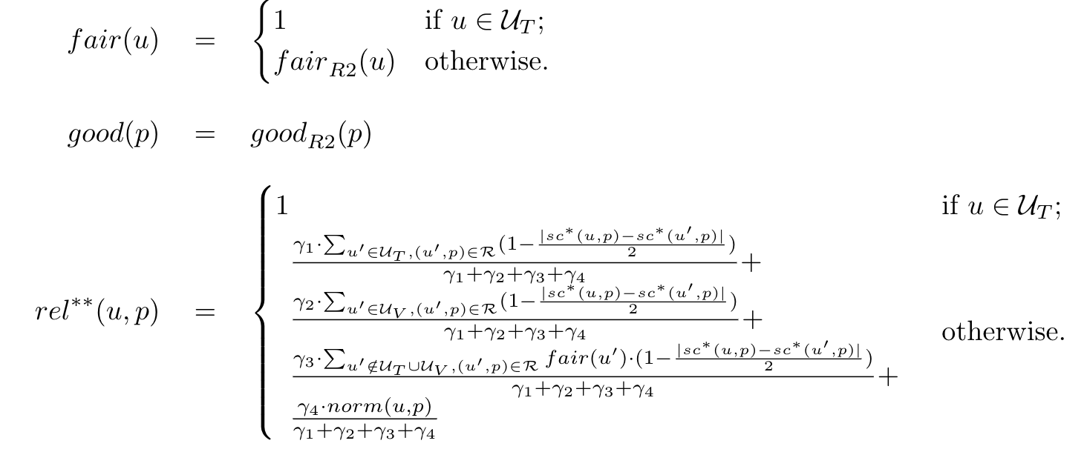
Model: Verified + Trusted users
Trusted users
Verified users

Slide 75
Experiments design for Trusted model
For the number of Trusted users
Include the trusted users
Perform the attacks on the model
Vary k (fraction of sockpuppets) and N (number of reviews), for each target T
For each configuration of alpha, beta, gamma
Compute average score for the users
For each q percentile (0.5%, 1%, 3%, 5%, 10%)
Compute precision, recall, f1
Compute improvement with respective to REV2
Compute average change on each q percentile
Compare with other algorithms

Slide 76
Experiments design for Verified + Trusted model
For the number of Trusted users
For the number of Verified users
Include the trusted and verified users
Perform the attacks
Vary k (fraction of sockpuppets) and N (number of reviews), for each target T
For each configuration of alpha, beta, gamma
Compute average score for the users
For each q percentile (0.5%, 1%, 3%, 5%, 10%)
Compute precision, recall, f1
Compute improvement with respective to REV2 and the Trusted-only algorithm
Compute average change on each q percentile
Compare with other algorithms

Slide 77
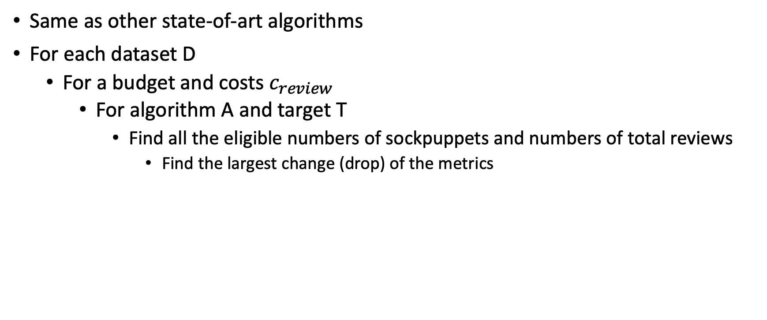
Budget experiments for REV2* (Trusted) and REV2**(Trusted and Verified)
Same as other state-of-art algorithms
For each dataset D
For a budget and costs $c_{review}$
For algorithm A and target T
Find all the eligible numbers of sockpuppets and numbers of total reviews
Find the largest change (drop) of the metrics

Slide 78
Current progress on the baseline experiments and our proposed algorithm
Based on the current progress, the estimation of the remaining experiments
The rev2 baseline experiments (hosted on anthill cluster of CS department) need around 10 days to finish
The fraud-eagle baseline experiments (hosted on discovery cluster of the college) need around 2 weeks to finish
Finished implementing the proposed RTV (review-trusted-verified) algorithm
Testing on a server

Slide 79
Old slides

Slide 80
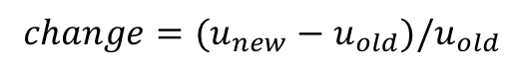
Heatmap (BN on alpha @ q=0.02)
$$change=(u_{new}−u_{old})/u_{old}$$
The change depends on both k and N values

Slide 81
Heatmap (BN on alpha @ q=0.1)

Slide 82
Heatmap (BN on alpha @ q=0.2)

Slide 83
Heatmap (rsd on alpha @ q=0.1)
The change rely on k much more than N

Slide 84
Heatmap (rsd on alpha @ q=0.1)
The change rely on k much more than N

Slide 85
Heatmap (rsd on alpha @ q=0.1)
The change rely on N more than k

Slide 86
Algorithms on datasets (f1 @ q=0.02)
 | bn | feagle | fraudar | trust | rsd | bad | rev2
alpha | -0.378 k=0.90 n=25 | -0.626 k=0.90 n=50 | -0.795 k=0.90 n=1 | -0.536 k=0.90 n=25 | -0.582 k=0.90 n=10 | -0.755 k=0.90 n=40 | -0.779 k=0.90 n=1
amazon | -0.809 k=0.90 n=40 |  |  |  |  | -0.933 k=0.90 n=50
epinions
otc | -0.475 k=0.90 n=30 |  | -0.759 k=0.90 n=1 | -0.535 k=0.90 n=50 | -0.605 k=0.90 n=5 | -0.692 k=0.90 n=50

Slide 87
Algorithms on datasets (f1 @ q=0.1)
Changes are smaller than q=0.02
 | bn | feagle | fraudar | trust | rsd | bad | rev2
alpha | -0.051 k=0.90 n=40 | -0.432 k=0.90 n=50 | -0.704 k=0.90 n=1 | -0.288 k=0.90 n=50 | -0.358 k=0.90 n=45 | -0.624 k=0.90 n=45 | -0.735 k=0.90 n=1
amazon | -0.427 k=0.70 n=50 |  |  |  |  | -0.868 k=0.70 n=50
epinions
otc | -0.258 k=0.90 n=35 |  | -0.588 k=0.70 n=1 | -0.334 k=0.90 n=50 | -0.433 k=0.90 n=5 | -0.502 k=0.50 n=40

Slide 88
Algorithms on datasets (f1 @ q=0.2)
Changes are even smaller than q=0.1
 | bn | feagle | fraudar | trust | rsd | bad | rev2
alpha | 0.311 k=0.90 n=50 | -0.003 k=0.90 n=50 | -0.529 k=0.50 n=1 | -0.062 k=0.90 n=50 | -0.010 k=0.90 n=15 | -0.367 k=0.40 n=50 | -0.623 k=0.70 n=1
amazon | -0.031 k=0.70 n=50 |  |  |  |  | -0.733 k=0.30 n=35
epinions
otc | 0.111 k=0.80 n=50 |  | -0.276 k=0.20 n=1 | 0.013 k=0.90 n=50 | -0.160 k=0.90 n=5 | -0.282 k=0.10 n=40

Slide 89
Algorithms on datasets (precision @ q=0.1)
Precision are larger.
 | bn | feagle | fraudar | trust | rsd | bad | rev2
alpha | 1.406 k=0.10 n=45 | 0.340 k=0.10 n=45 | -0.110 k=0.90 n=1 | 0.915 k=0.10 n=40 | 0.688 k=0.30 n=15 | -0.032 k=0.30 n=50 | -0.221 k=0.90 n=1
amazon | 1.087 k=0.10 n=35 |  |  |  |  | -0.478 k=0.30 n=40
epinions
otc | 1.017 k=0.10 n=45 |  | -0.007 k=0.30 n=1 | 0.944 k=0.90 n=50 | 0.700 k=0.20 n=5 | 0.101 k=0.10 n=35

Slide 90
Algorithms on datasets (recall @ q=0.1)
The sockpuppets have big impact on recall numbers.
 | bn | feagle | fraudar | trust | rsd | bad | rev2
alpha | -0.390 k=0.90 n=40 | -0.616 k=0.90 n=50 | -0.812 k=0.90 n=1 | -0.524 k=0.90 n=50 | -0.576 k=0.90 n=45 | -0.748 k=0.90 n=45 | -0.834 k=0.90 n=1
amazon | -0.675 k=0.70 n=50 |  |  |  |  | -0.927 k=0.70 n=50
epinions
otc | -0.525 k=0.90 n=30 |  | -0.743 k=0.70 n=1 | -0.569 k=0.90 n=50 | -0.642 k=0.90 n=5 | -0.673 k=0.60 n=40

Slide 91
The next step: How to defend against attack
K: the number of sockpuppets
Affect algorithms that rely on rating distributions, for example, birdnest, and trust
N: number of reviews generated by one sockpuppet
Affect algorithms that rely on reputation, for example, BAD
Semi-supervised learning with partial ground truth
Label propagation
Graph embedding
Graph convolutional network

Slide 92
Experimental rounds
For each K, average over N and t
Average precision
AUC
Precision at 5% - 50% (top k precision)
Evade rate at 5% - 50% (top k evade rate)
Evaluate the metrics on fraudster/sockpuppet/combined
Then switch K and N to evaluate the impact of N

